Slide 1
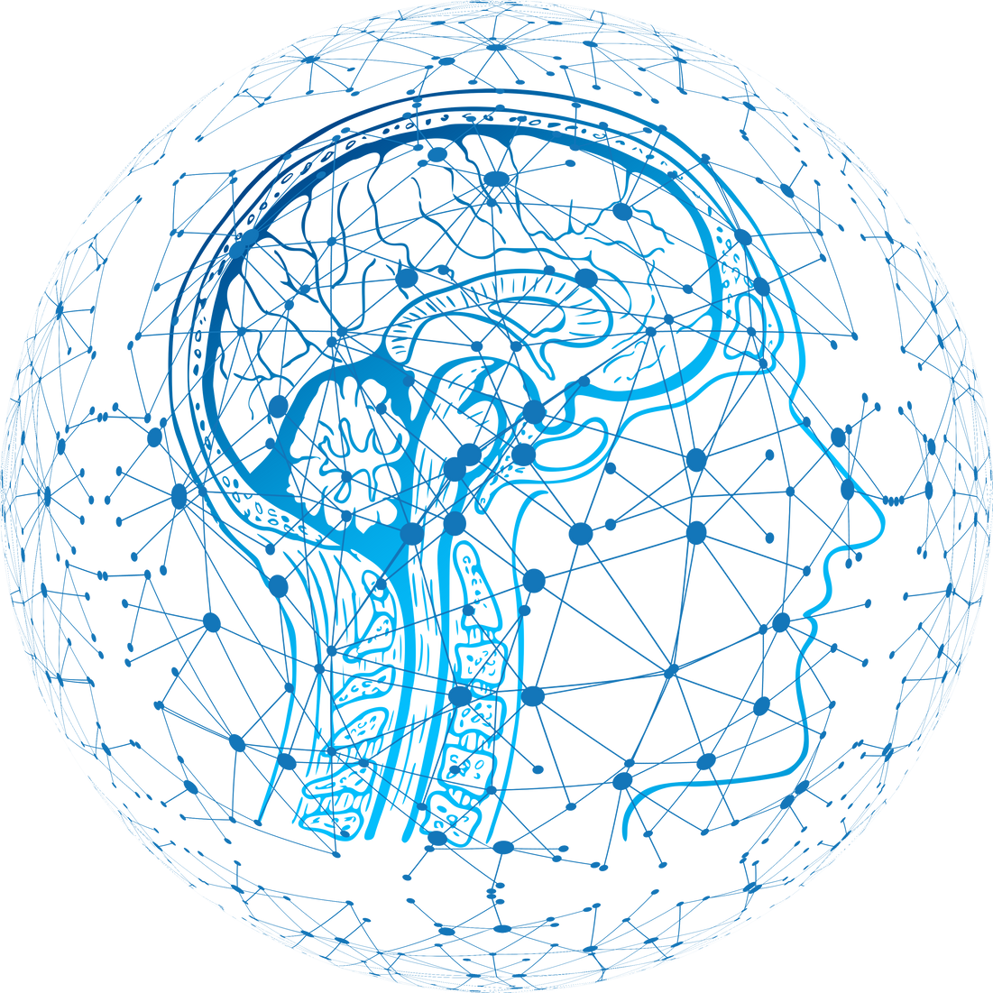
Should AI developers be responsible for making AI behave ethically ?
presented by Golam Muin-U-Ddin Chishti
01

Slide 2

About Artificial Intelligence
About Artifical Intelligence (AI)
About A.I Developers
AI is the field of computer science that focuses on creating machines or software that can perform tasks that normally require human intelligence.
AI is the field of computer science that focuses on creating machines or software that can perform tasks that normally require human intelligence
02

Slide 3

Why my argument is strong
Human free will matters
Just like humans misuse their God-given consciousness, they misuse tools.
Tools don’t create evil — people do.
Developers can’t predict every misuse
No one can anticipate every malicious human behavior or every creative loophole.
Shared responsibility makes more sense
Responsibility must be distributed among:
Developers
Companies
Governments
Users
Society
8. Developers build tools; users choose actions
9.The moral weight belongs to human intent.
02
04
03

Slide 4
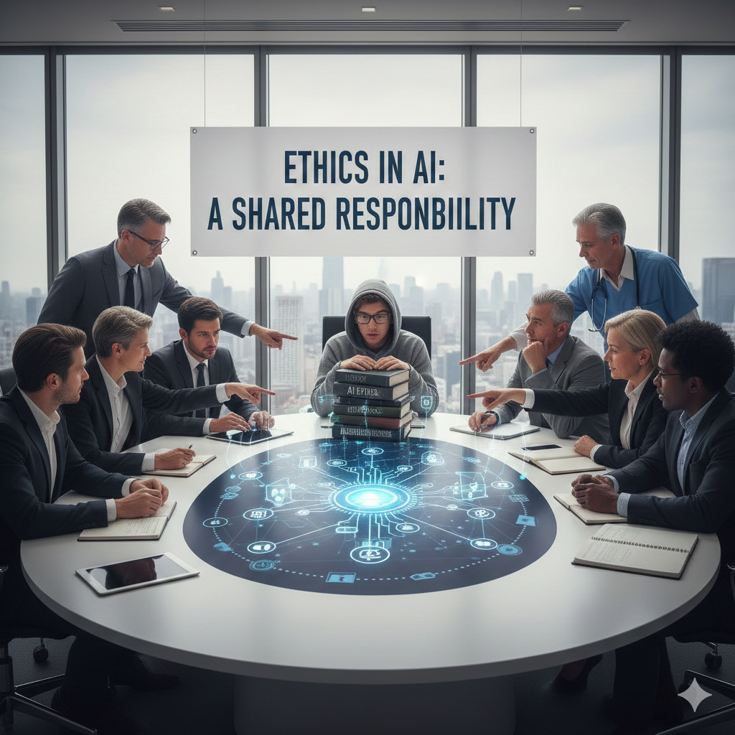
Why AI Developers Should Not Bear Full Ethical Responsibility
Just as humans have consciousness yet still choose wrongdoing, misuse is a human choice—not solely a creator’s fault.
01
Even when AI developers design systems with strict rules, users can intentionally bypass them.
02
Like architects who design safe buildings but cannot control every external failure, developers cannot predict every misuse scenario
03
Millions use AI for positive, everyday tasks, but a small group actively seeks to exploit systems.
04
04

Slide 5
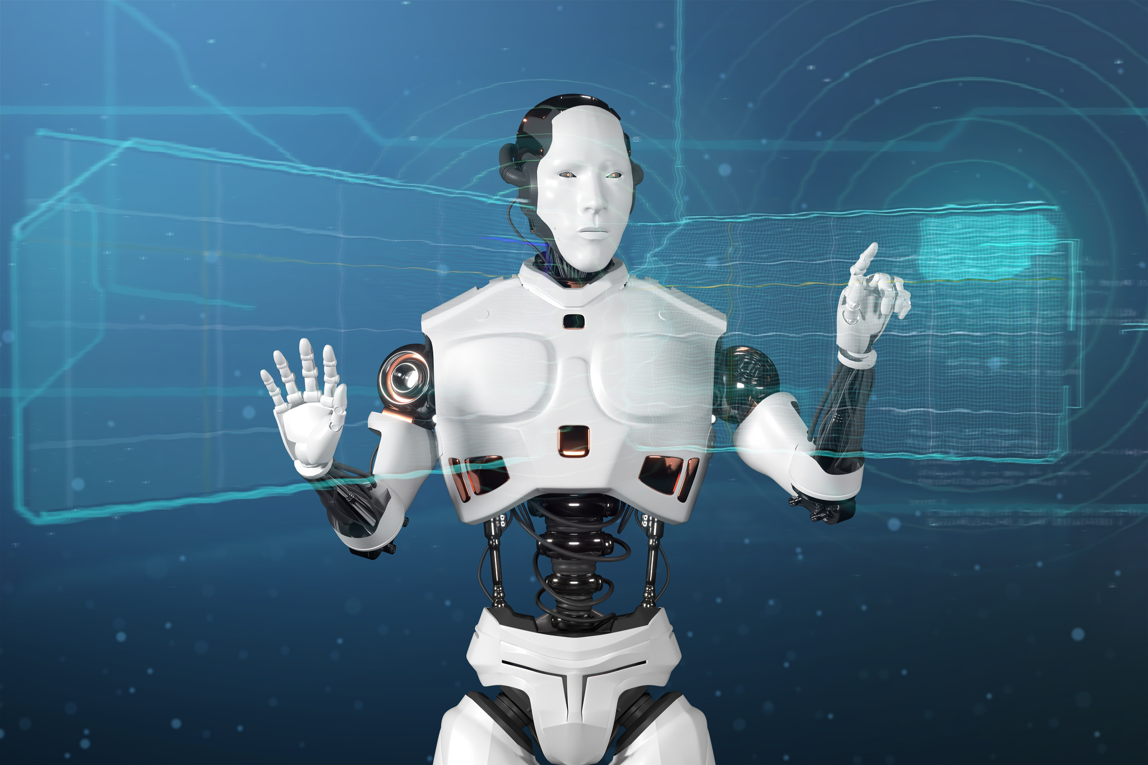
When Developer Responsibility Becomes Critical
Once AI evolves into advanced or superintelligent systems, developers must focus more seriously on embedding core ethical principles.
At higher levels of autonomy, design choices impact global safety.
Future AI must include strong guardrails to limit immoral use while maximizing benefits.
05

Slide 6
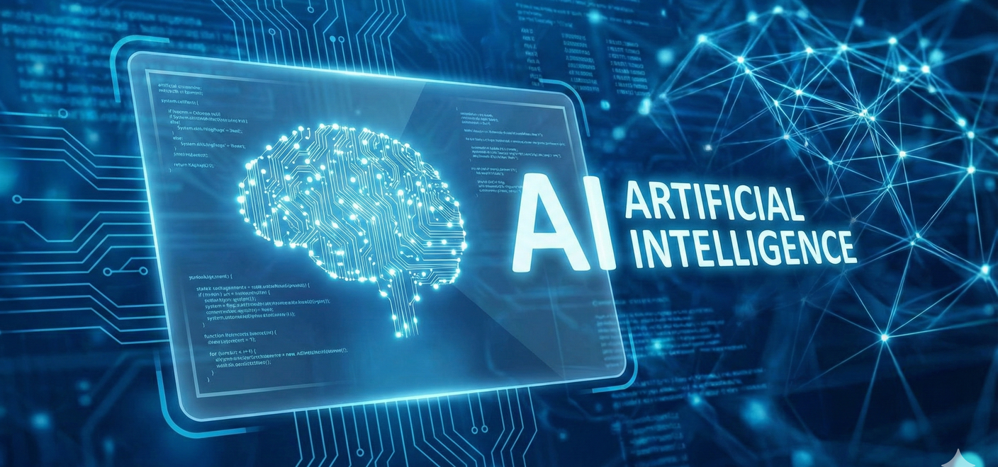
The Importance of AI Ethics
Why AI Ethics Matters for Leaders
What AI Ethics Examines
Environmental & Workforce Impacts
01
AI ethical literacy helps leaders identify potential risks early.
Protects organizations from lawsuits, compliance violations, and reputational damage.
Enables leaders to understand the larger landscape of the coming AI-Age.
Helps balance innovation with responsible use of AI technologies.
02
03
AI data centers consume significantly more water than traditional data centers.
Increased energy usage heightens environmental responsibility.
AI leaders (e.g., Dario Amodei, CEO of Anthropic) predict major job disruptions.
Up to 50% of entry-level white-collar jobs may be replaced within five years.
Societal impacts of widespread AI adoption.
Fairness, bias, and discrimination in AI systems.
Privacy and data-protection concerns.
06

Slide 7


Thank you .
END OF THE PRESENTATION
07

